Slide 1


Scupa: Single-cell unified polarization assessment of immune cells using the single-cell foundation model
Wendao Liu, Zhongming Zhao
QS seminar
8/26/2024

Slide 2
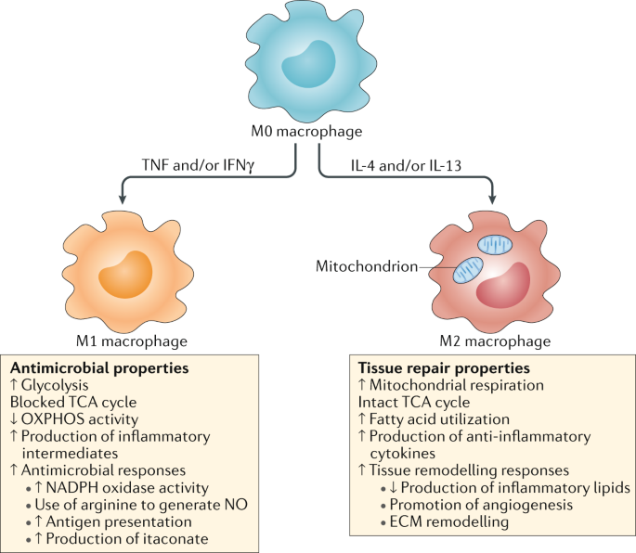
Immune cell polarization and cytokines
Immune cells adopt significant changes in the transcriptional profiles and functional states in response to certain factors
Cytokines are potent intracellular signaling molecules and may drive immune cell polarization
Famous example: macrophage M1/M2 polarization
More polarization states
Russell et al. Nat Rev Immunol. 2019

Slide 3
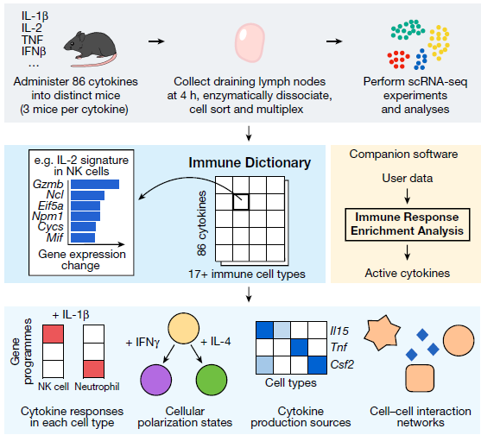
Immune Dictionary
A compendium of single-cell transcriptomic profiles of lymph node immune cells in response to each of 86 cytokines
Identified 66 immune cell polarization states across 14 cell types
A valuable reference for investigating cytokine effect and immune cell polarization
Cui et al. Nature. 2024

Slide 4
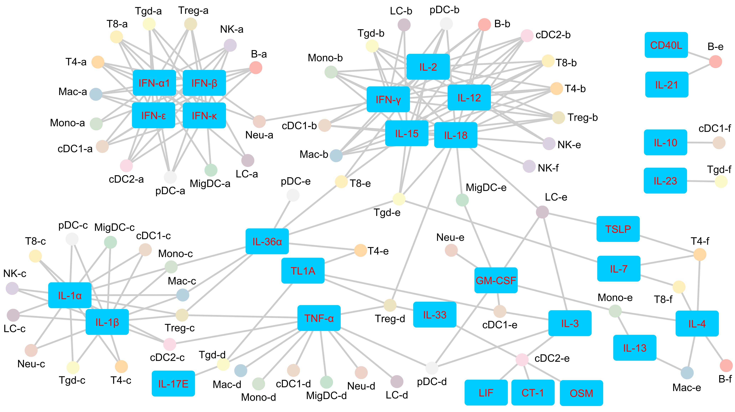
Immune cell polarization states
Polarization states with driving cytokines
Transfer these knowledge to other scRNA-seq studies?
Cui et al. Nature. 2024

Slide 5
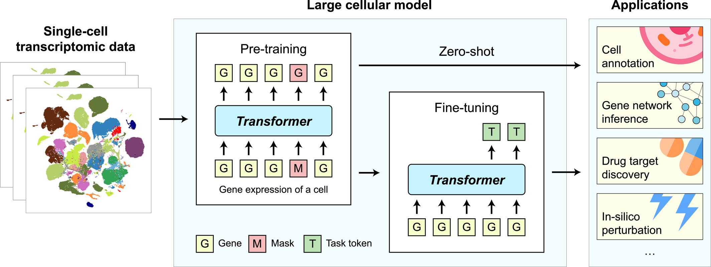
Single-cell foundation models
Transformer architecture like large language models
Pretrained on massive scRNA-seq data
scBERT (Nat Mach Intell 2022), Geneformer (Nature 2023), scGPT (Nat Methods 2024), scFoundation (Nat Methods 2024), UCE (bioRxiv 2023), …
Ability to transfer knowledge across studies
Hao et al. Quant Biol. 2024

Slide 6
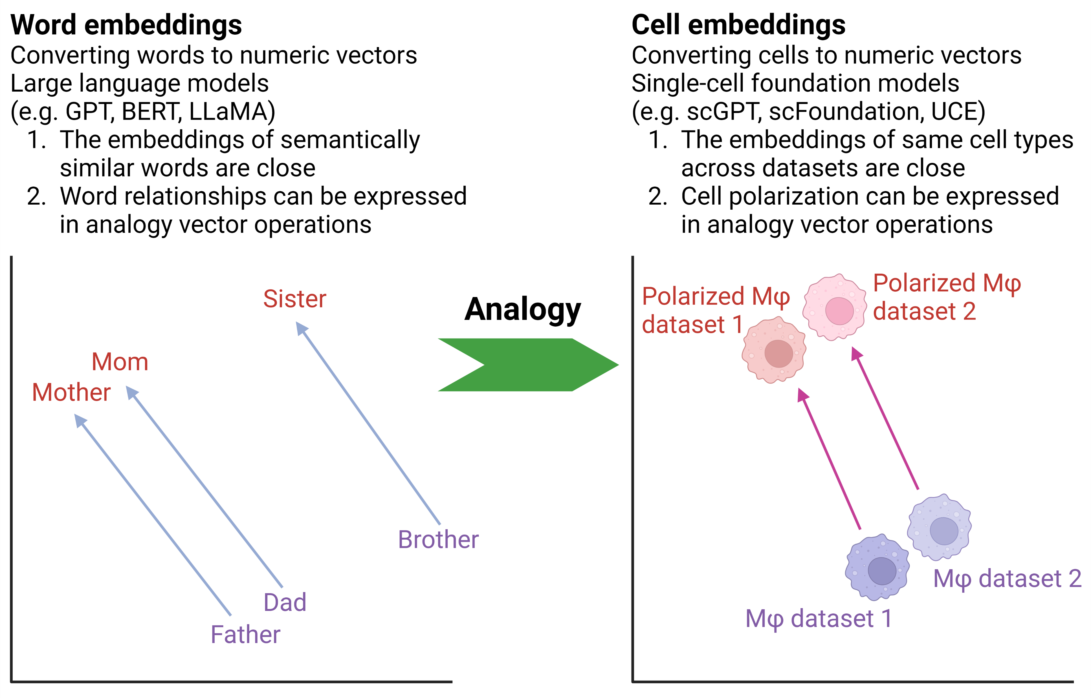
Representing immune cell polarization using single-cell foundation models
Are there similarities in transformer-based language foundation model and transformer-based single-cell foundation models?
BERT: 768~1024-d vector
GPT-3: 768~4096-d vector
scGPT: 512-d vector
UCE: 1280-d vector

Slide 7
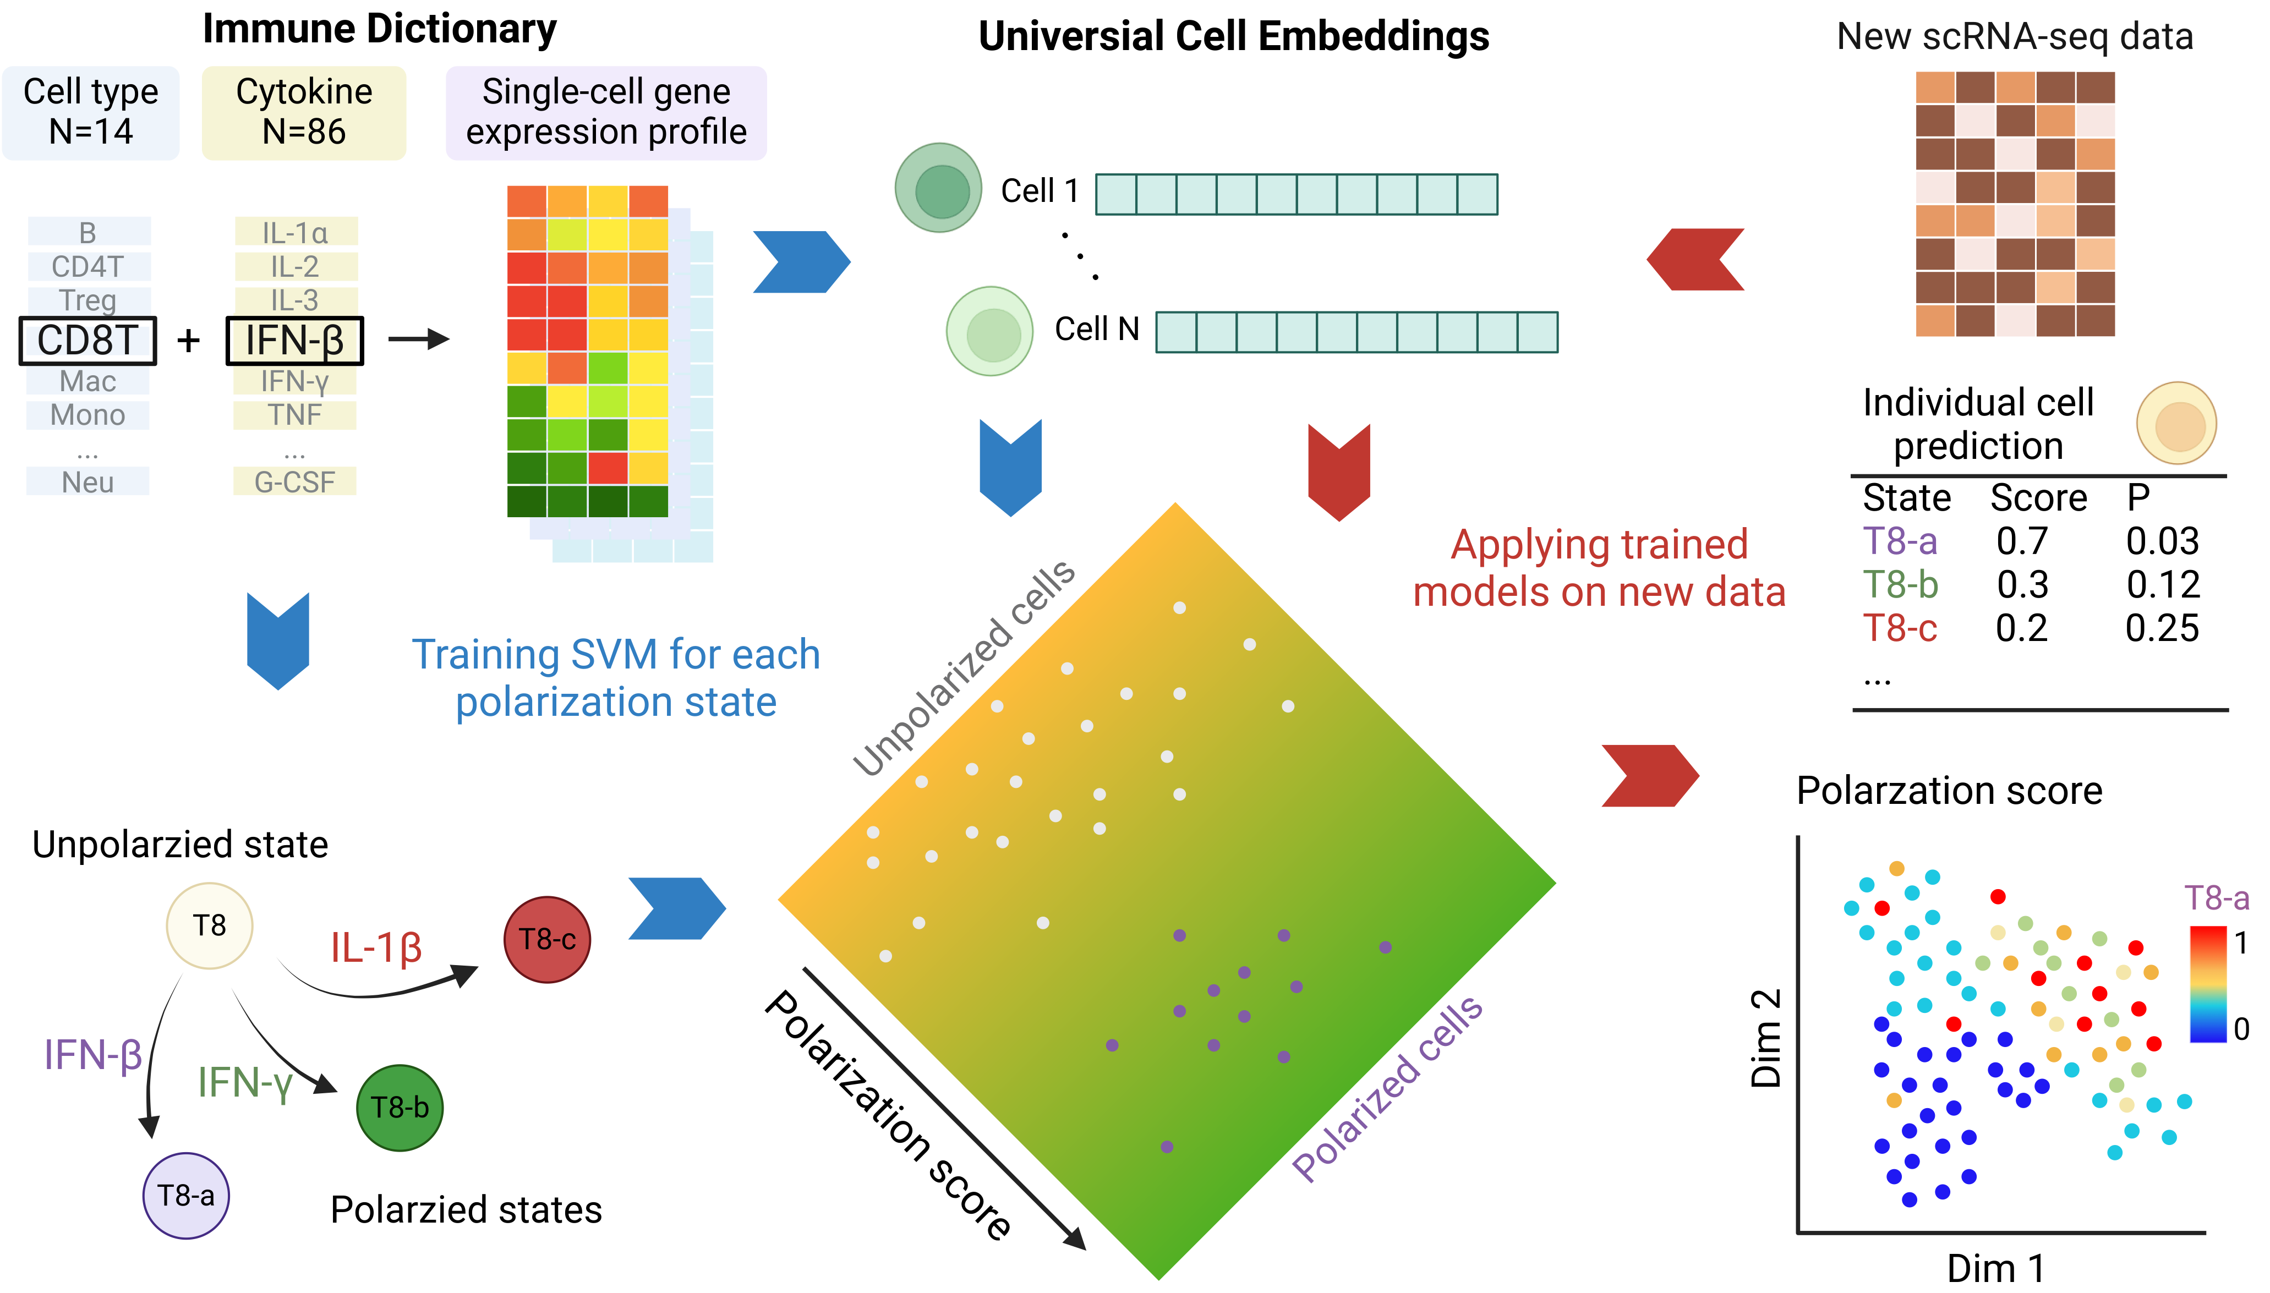
Scupa framework
Single-cell unified polarization assessment
UCE’s important properties:
multi-species compatibility
‘Zero-shot’ capability
Rosen et al. bioRxiv. 2023

Slide 8
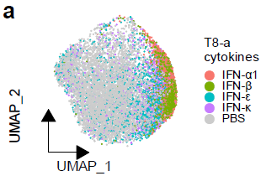
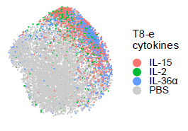
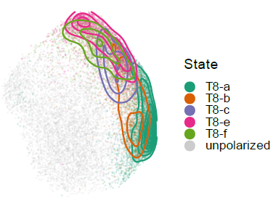
Cell embedding shifts in cell polarization
Cell embeddings of polarized cells shift away from unpolarized cells
Identified ‘fully’ polarized cells by:
Cosine similarity with other polarized cells
Marker gene expression
Machine learning models to classify ‘fully’ polarized cells and unpolarized cells
Overall best performance: support vector machines
UMAPs generated from cell embeddings

Slide 9
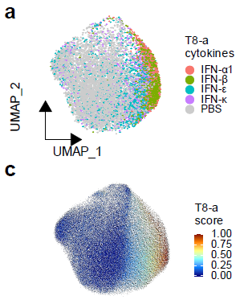
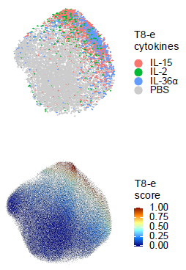
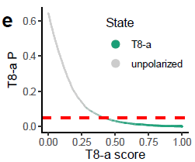
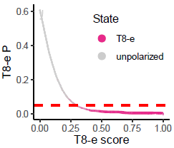
Scupa learns the representation of immune cell polarization
Polarization score:
0 (unpolarized) ~ 1 (fully polarized)
Polarization p-value:
H0: observed cell is unpolarized
P(score >= observed score | H0)
Non-parametric
Empirical threshold: p=0.05
Scupa prediction

Slide 10
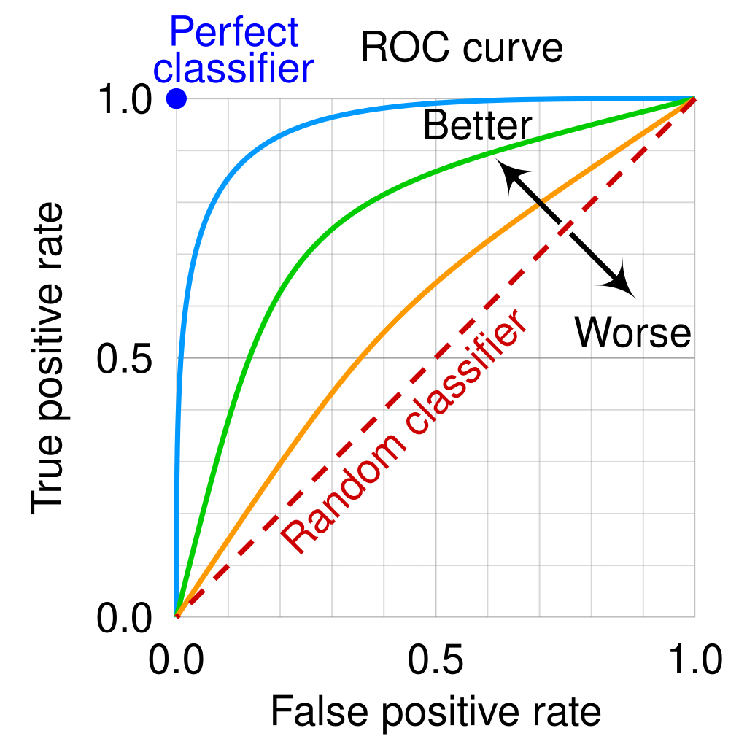
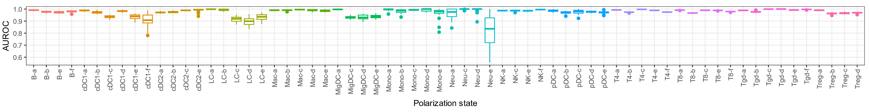
Evaluation of Scupa
Wikipedia
ROC curve and AUC for evaluating classifier performance
70/30 random split, 20 repeats
Median AUC>0.95: 56/66 polarization states
Median AUC>0.9: 64/66 polarization states

Slide 11
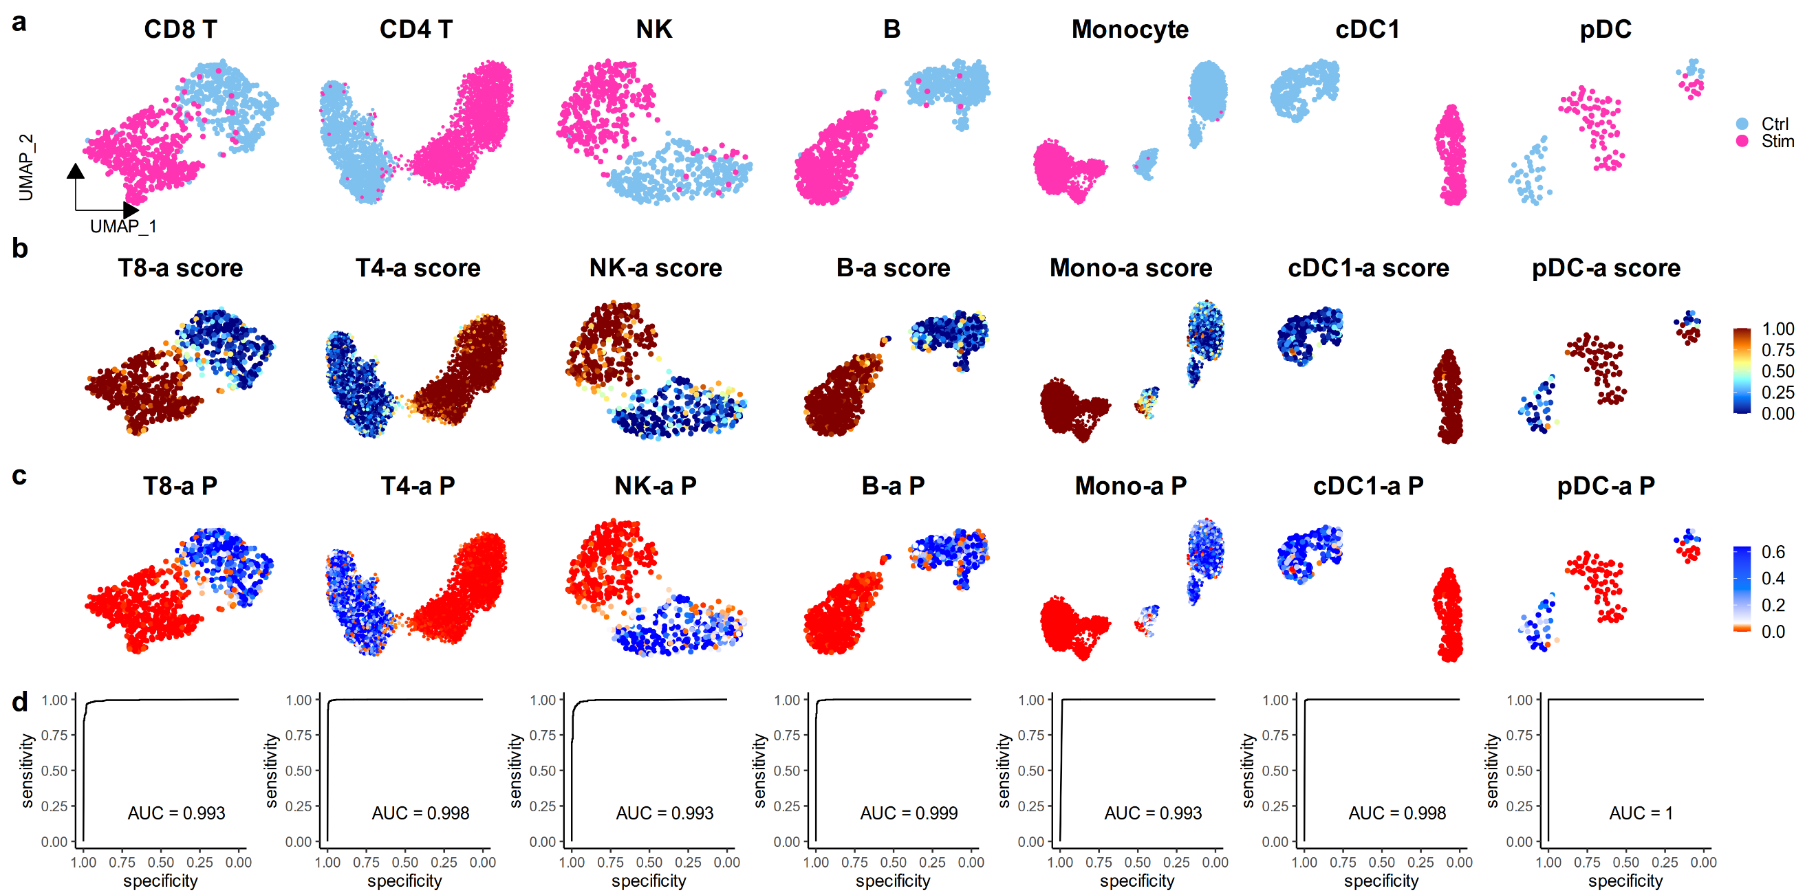
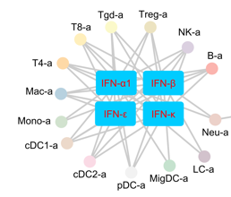
Validation of Scupa using independent in vitro data
Human PBMCs treated with IFN-β or not
Kang et al. Nat Biotechnol. 2018

Slide 12
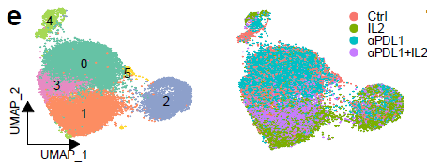
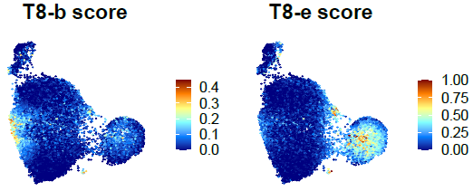
Validation of Scupa using independent in vivo data
LCMV infected mice treated with IL-2 or anti-PD-L1
Spleen CD8+ T cells for scRNA-seq
IL-2 drives T8-b and T8-e polarization
More cells polarized to T8-e than T8-b
Hashimoto et al. Nature. 2022

Slide 13
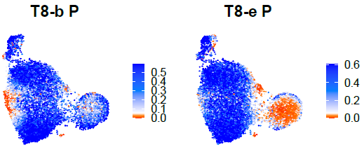
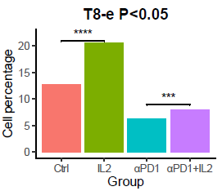
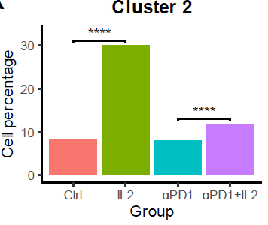
Validation of Scupa using independent in vivo data
In vivo cytokine treatment only drives polarization of a subset of cells
Cluster 2 was enriched with T8-e polarized cells
T8-e polarized cells significantly increased after IL-2 treatment
Cluster 2

Slide 14
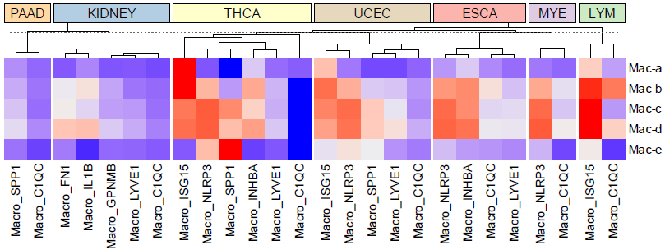

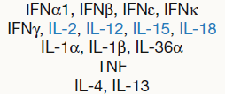
Analyzing pan-cancer macrophage polarization using Scupa
Unpolarized: C1QC+, LYVE1+ macrophages
Mac-a: ISG15+ macrophages
Proinflammatory M1-like Mac-b/c/d: NLRP3+, INHBA+ macrophages
M2-like Mac-e: SPP1+ macrophages (THCA)
Driving cytokines
Cheng et al. Cell. 2021

Slide 15
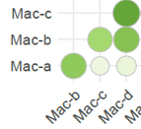
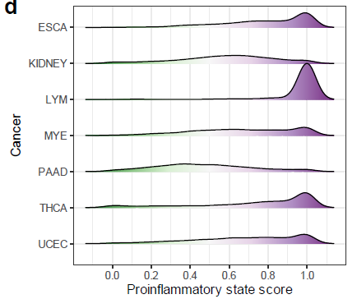
Macrophage inflammatory status across cancers
Mac-b/c/d scores are highly correlated, and these states are all driven by proinflammatory cytokines
Proinflammatory state score = MAX(Mac-b/c/d polarization score)
Overall proinflammatory status:
LYM > ESCA ≈ THCA > UCEC ≈ MYE > KIDNEY > PAAD

Slide 16
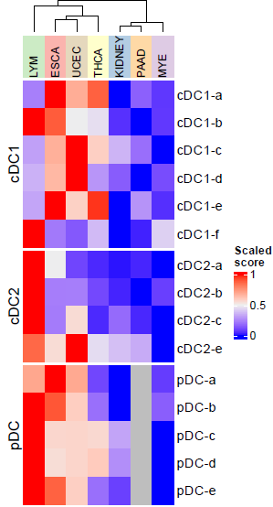
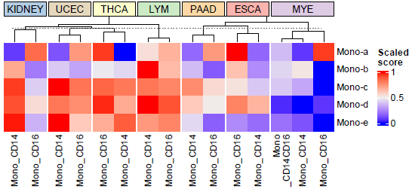
Analyzing pan-cancer monocyte and DC polarization using Scupa
Myeloid cells are
More polarized in LYM, UCEC, THCA, ESCA
Less polarized in MYE, KIDNEY, PAAD
Distinct cytokine environments

Slide 17
Summary
We developed Scupa, the first computational method for comprehensive immune cell polarization assessment (66 polarization states in 14 immune cell types) using scRNA-seq data
Scupa leverages the immunological knowledge from Immune Dictionary and the single-cell foundation model UCE
Scupa complements conventional scRNA-seq data analysis by providing new insights into immune cell polarization and cytokine effects
Applications in independent datasets have demonstrated:
Identifying polarized immune cells
Revealing distinct polarization profiles in cancers

Slide 18


Paper and software
Scupa is available as a R package on Github
Paper: https://www.biorxiv.org/content/10.1101/2024.08.15.608093
Code: https://github.com/bsml320/Scupa/

Slide 19
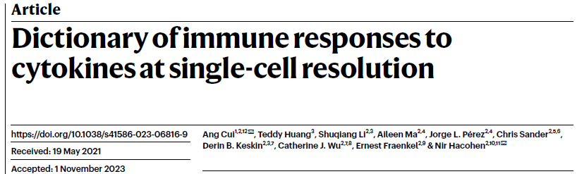
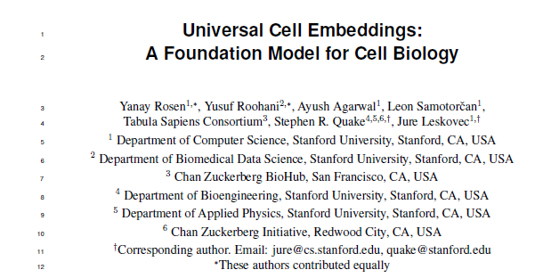

Acknowledgement
Dr. Zhao and members in Zhao lab
Pioneer studies:
Immune Dictionary
Universal Cell Embeddings
CPRIT BIG-TCR Predoctoral Fellowship
John and Rebekah Harper Fellowship in Biomedical Sciences

Slide 20
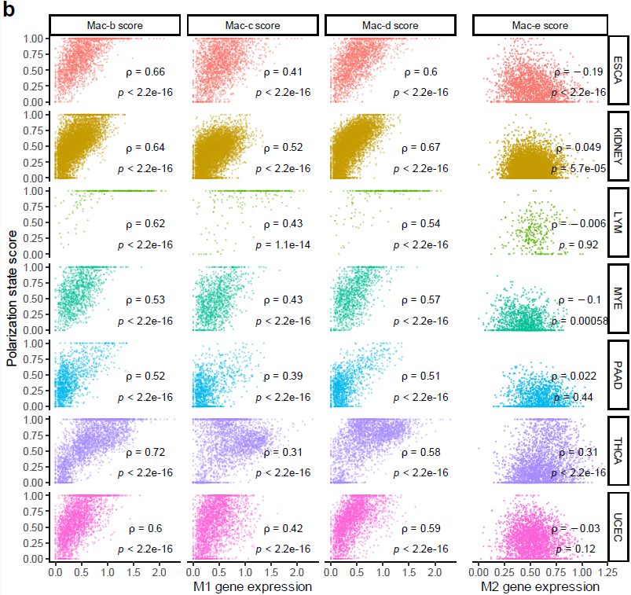
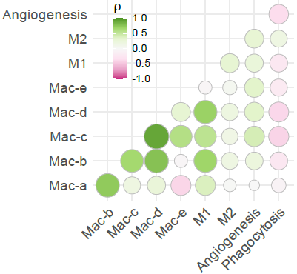
Polarization scores and signature gene expression
High correlation: Mac-b/c/d score with M1 gene expression
Almost no correlation: Mac-e score with M2 gene expression
Medium positive correlation: Mac-b/c/d score with angiogenesis gene expression
Negative correlation: phagocytosis with all polarization scores

Slide 21
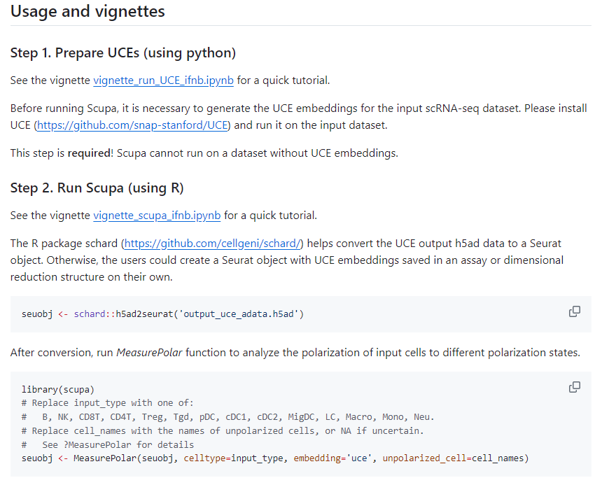

Slide 22
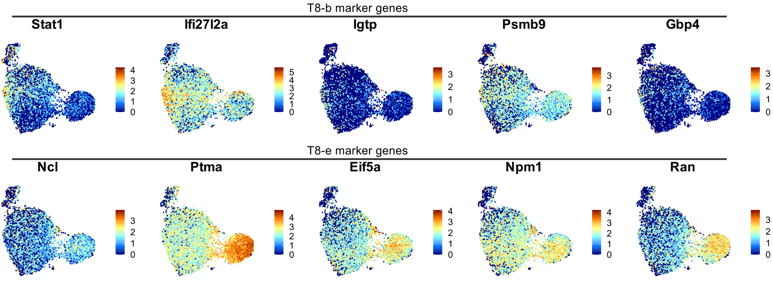
Polarization state markers

Slide 23
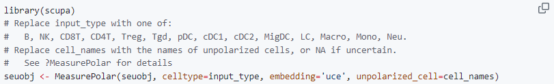
Cross-dataset batch effect correction
UCE and Scupa are robust to dataset and batch-specific artifacts
Adjust cell embeddings according to unpolarized cells in the input dataset
$$emb_{k, adjusted}=emb_{k,original}−c_{in}+c_{ref}$$

Slide 24
Limitations
Unidentified cytokine-driven polarization states
E.g. chemokine-driven
Non-cytokine pathways of immune cell polarization
E.g. hypoxia and lactate
Evaluation in and adaptation to species other than human and mouse

